Slide 1
Bridging Deep Learning and Symbolic Regression
--A Hybrid Approach for Interpretability and Expressiveness
Mingqian Wang
Mentor: Matthew Singh Department of Statistics

Slide 2
Outline
Motivation & Background
Technical Foundations
Methods
Results & Interpretation
Next Steps

Slide 3
Background
Deep learning: accurate but black-box
Symbolic regression: a technique that searches for mathematical expressions to best fit a given dataset, which is interpretable but struggles with noisy/high-dimensional data
Goal: Combine both techniques together and design models that extract symbolic expressions directly from data
Why it matters: Scientific fields need interpretable models

Slide 4
Previous Work
EQL (Equation Learner) Network
A neural network designed for symbolic regression by replacing traditional activations with symbolic operators
Each neuron applies a predefined mathematical operation like:
1
Network learns how to combine these operations to fit data

Slide 5

Issues Observed in Practice
Sensitive to input range (e.g., fails for
Needs many samples to disambiguate function forms
Poor performance to high dimensions
Adding too many primitives → convergence failure and increased overfitting
Exploding gradients and NaN values

Slide 6

Motivation
General symbolic models fail without assuming any prior structure
Key idea: restrict on target function forms like:
Assumption: inputs are positive
Goal: solve core issues (instability, sparsity, scalability) within this simpler, restricted but still expressive framework

Slide 7


PowerActivation Module
Custom activation:
Learnable scalar C, exponents
Goal: Encodes multiplicative monomials directly
Aim: learn the monomial part in the true target function

Slide 8
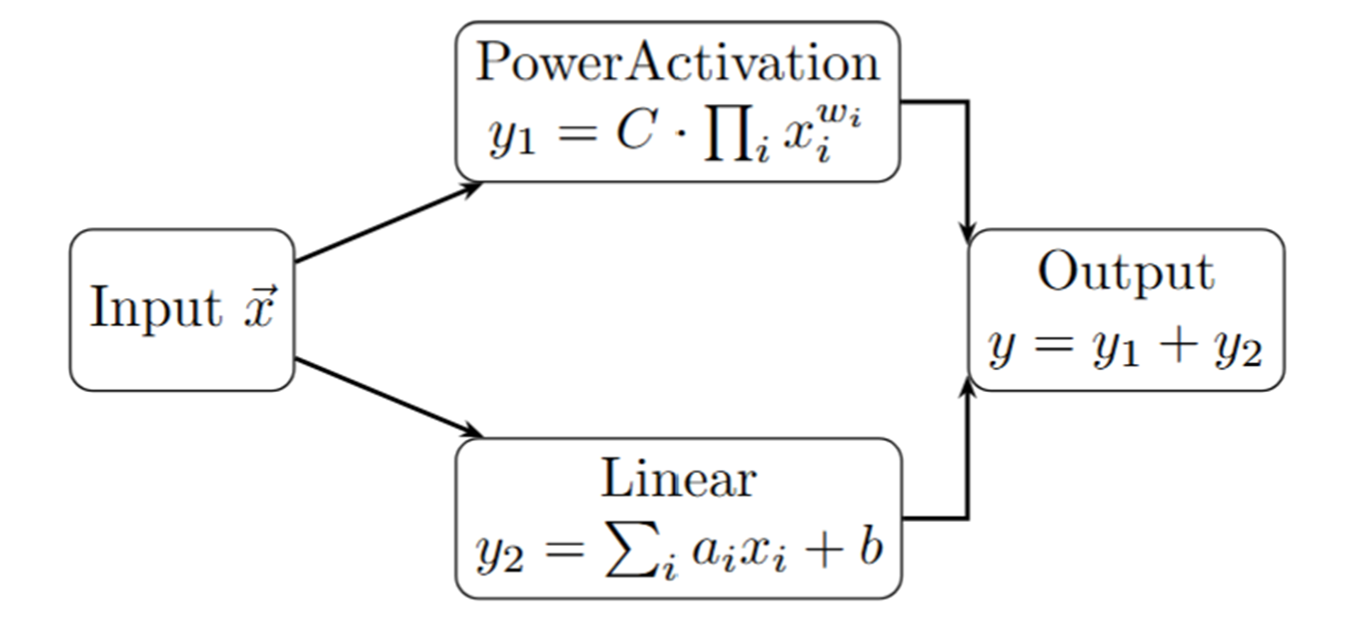
Architecture Overview
2-stage design:
Stage 1: Power + Linear terms
Stage 2: Compose stage 1 outputs(Addition)
Enables modular symbolic composition

Slide 9
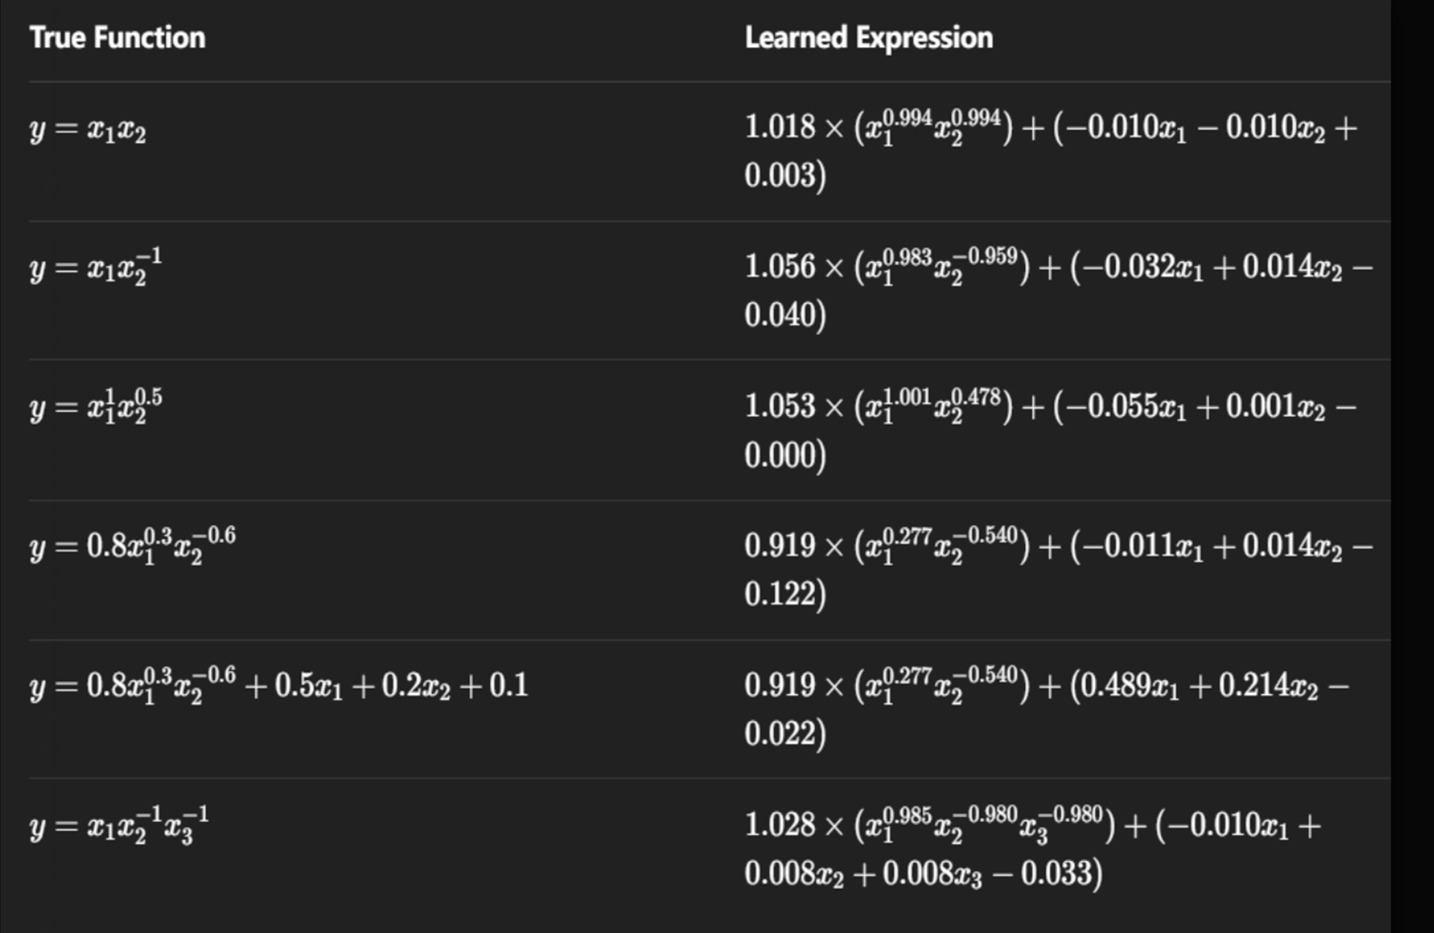
Results

Slide 10
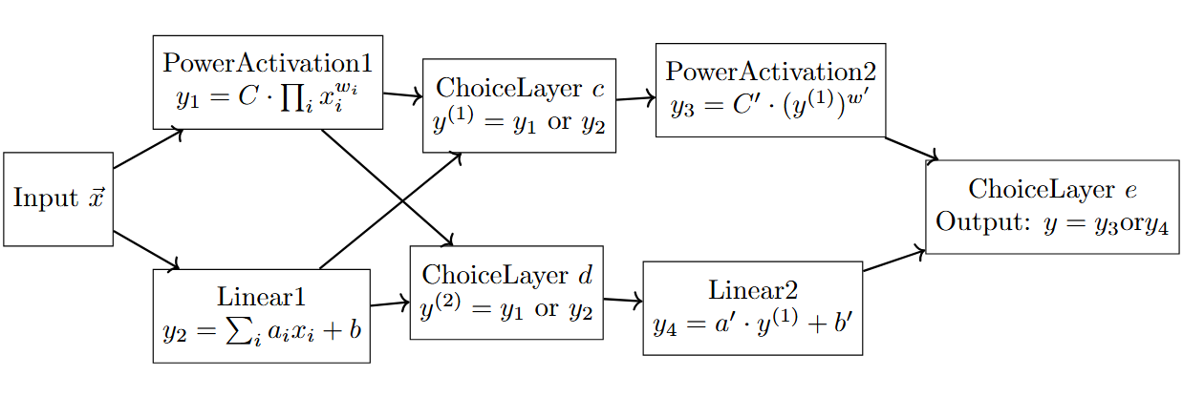
Deeper Model

Slide 11
Technical Enhancements
ChoiceLayer: Modular Discrete Selection
Takes multiple candidate inputs (e.g., power_out, linear_out)
Learns to select one using trainable logits
Enables sparsity: only one path is active per decision point
STE (Straight-Through Estimator)
Discrete selection isn't differentiable → use softmax + argmax on logits
Forward pass: hard argmax for selection
Backward pass: gradient flows through softmax (relaxed path)
Allows discrete decisions to be trained with gradient descent

Slide 12
Technical Enhancements
Pruning:
After convergence, fix the selected paths
Remove unused branches → reduce complexity
Noise Injection:
Add Gaussian noise to logits during early training
Prevents early overcommitment to suboptimal decisions
Reinitialization:
After pruning, reinitialize weights in retained layers
Helps model to learn coefficients

Slide 13
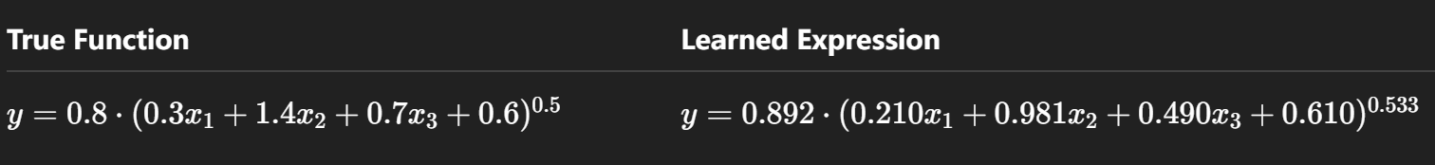
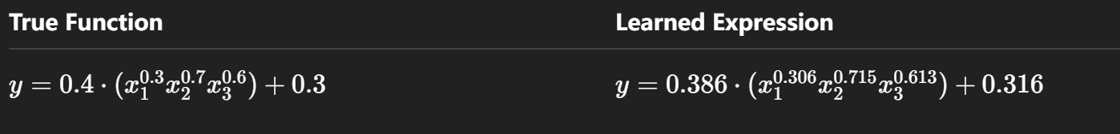
Results
Case1:Linear Inside, Power Outside
Case2: Power Inside, Linear Outside
The model closely recovered the structure and coefficients of the target function and distinguished two different function structures.

Slide 14
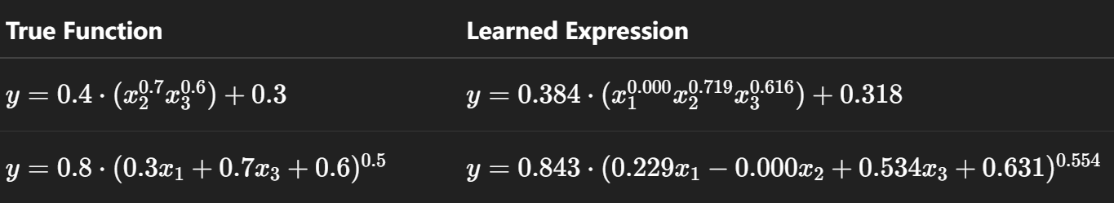
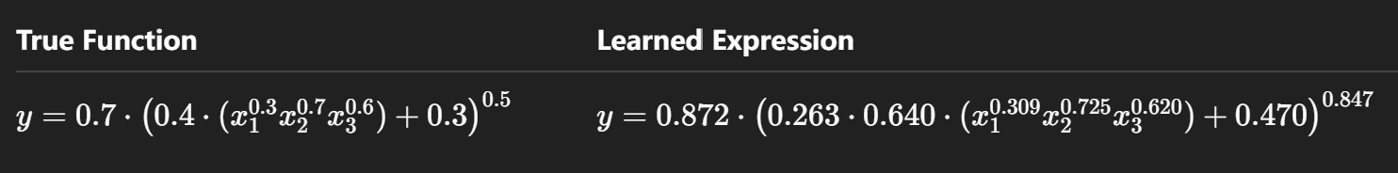
Results
Case3:Irrelevant Variables
Case4: Nested Structure(Depth = 3)

Slide 15
Findings & Insights
Cutoff & Pruning Strategy
The cutoff rule for pruning switches is crucial:
Try a fixed threshold for a few epochs.
Or prune after switches remain stable for a given number of epochs.
Challenge: switches can make early wrong choices that propagate forward
Choice Layer & Sparsity
ChoiceLayer introduces discrete path selection.
Encourages sparse, interpretable computation
Ensures only the necessary components of the network remain active.
Parameter Initialization Matters
Learning fails if the true coefficient is outside the initialization range.
Run multiple trials to better approximate the true coefficient.

Slide 16
Next Steps
Architectural Enhancements
Add skip connections (ResNet-style) to help preserve early-learned structures.
Feed input variables into later layers to form increasing-depth networks.
Broader Symbolic Scope
Support richer symbolic operators (e.g., log, sin).
Extend models to real-world scientific datasets.
Extend to real-world scientific data
Account for measurement noise and incomplete inputs

Slide 17
References
Bengio, Y., Léonard, N., & Courville, A. (2013). Estimating or Propagating Gradients Through Stochastic Neurons for Conditional Computation. arXiv:1308.3432
Liu, Z., Wang, Y., Vaidya, S., Ruehle, F., Halverson, J., Soljačić, M., Hou, T. Y., & Tegmark, M. (2024). Kolmogorov–Arnold Networks.arXiv:2404.19756
S. Kim et al., Integration of Neural Network-Based Symbolic Regression in Deep Learning for Scientific Discovery, in IEEE Transactions on Neural Networks and Learning Systems, vol. 32, no. 9, pp. 4166-4177, Sept. 2021, doi: 10.1109/TNNLS.2020.3017010
arXiv:1308.3432

Slide 18
Thank You!
arXiv:1308.3432

